Slide 1
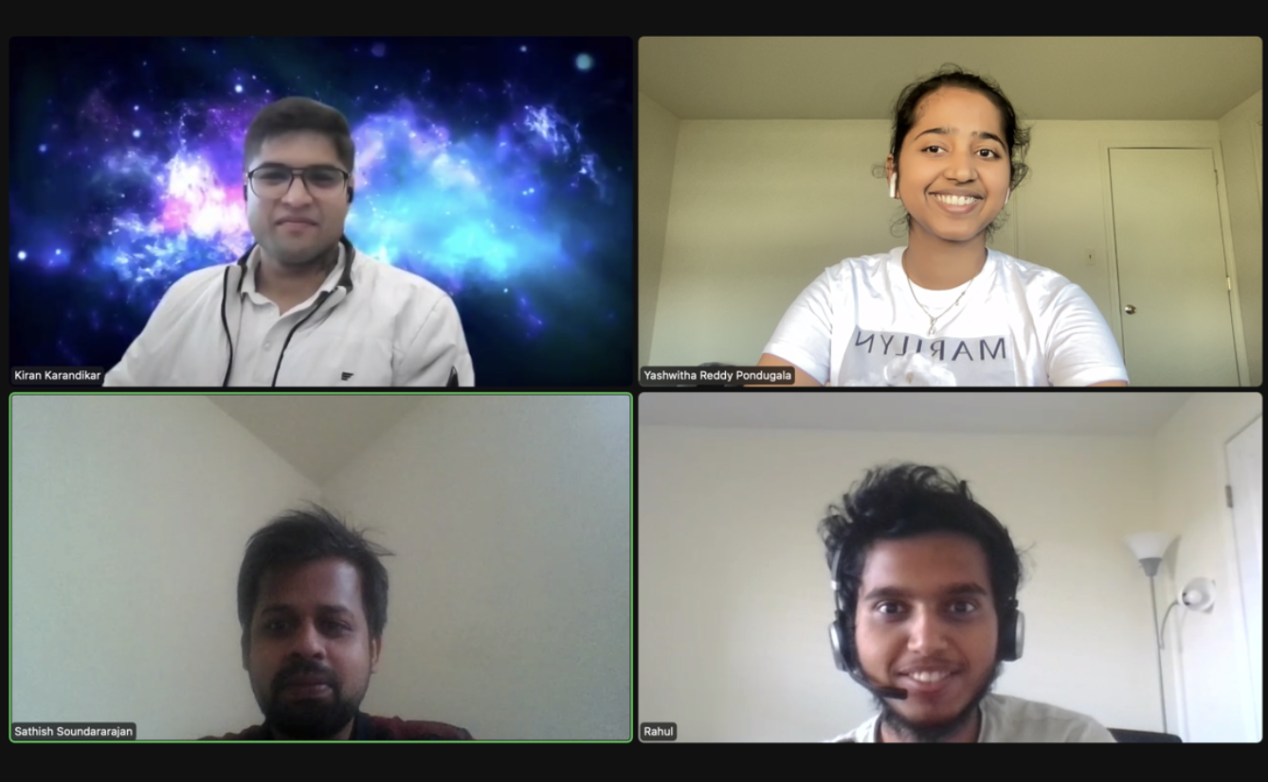
Home Credit Default Risk
Group 02
Kiran Karandikar(kikarand@iu.edu) Sathish Soundararajan(satsoun@iu.edu) Yashwitha Reddy Pondugala(ypondug@iu.edu)
Rahul Gomathi Sankarakrishnan(rgomathi@iu.edu)

Slide 2
Contents
Past developments in Phase 1
Phase 2 developments
Conclusion
Proposed plan for Phase 3

Slide 3
Past developments
Exploratory Data Analysis
We one-hot encoded all the category features for Feature Engineering
Built a baseline pipeline using logistic regression
Accuracy score on held out test set : 91.59%
AUC score: 0.7356
Training Time: 35.7s

Slide 4
Phase 2
Feature Engineering
Hyperparameter tuning

Slide 5
Experiments for Feature selection

Slide 6
Ensemble Methods

Slide 7
Conclusion
Proposed plan for Phase 3

